Slide 1
White-box Testing
Use of control flow graphs for optimum test coverage

Slide 2


Slide 3
What’s a good KPI for our functional tests?
Functional Coverage - So it meets the need
Code Coverage - So we know there’s nothing fishy lying around

Slide 4
How do we determine the optimal test cases for higher coverage?

Slide 5
Example
A web application that calculates insurance risk factor based on
Gender
Age group
Province of residence

Slide 6
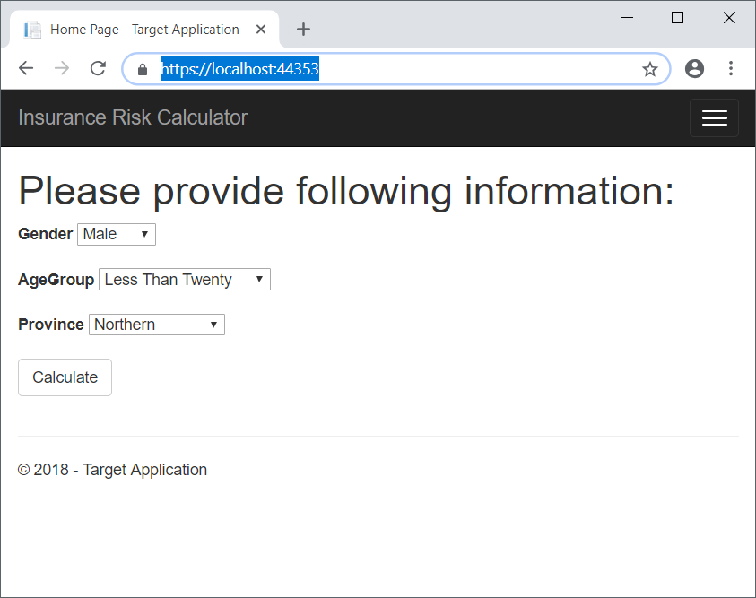
Example
2 Genders
4 Age Groups
9 Provinces

Slide 7
How many test cases should you write to achieve full coverage?
72?
50?
4?

Slide 8
What is white-box testing? (Old-school Term)
Testing conducted with the knowledge of how software is implemented

Slide 9
How does that fit in modern day ATDD?
ATDD follows the cycle
Discuss
Distill
Develop
Demo

Slide 10
Discuss
Developer, Quality Engineer and Product Owner discuss the user stories using examples
These examples help everyone understand how the business flow should happen
Developers use these examples to structure their approach
Qes use these examples to distill test cases
What if we go a step further?

Slide 11
The control flow graph for collaboration
At the ATDD discussion, Product Owner, Developer and Quality Engineer draws a control flow diagram - on paper or on a white board - to understand how the functionality is implemented.
QE will determine the test cases for optimal coverage of the control flow - which ensures optimal coverage of both functionality and code
Dev will update both QE and PO should anything go different, so that they could update the test cases accordingly

Slide 12
Back to our example
< 20 + 0.01
Central / Western/ Southern + 0.01
Male
+ 0.01
21 - 40 + 0.03
Sabaragamuwa / Uva / North Central / North Western + 0.02
0
0
41 - 60 + 0.05
Female + 0.02
Eastern / Northern + 0.03
60 < + 0.08

Slide 13

Demostration

Slide 14

Thank you! mahasen@gmail.com https://github.com/mahasenb/WhiteBoxTestingSample

